Slide 1
Scalable and secure infrastructure
With LUKS, ZFS and LXD
Notes:
We are Documaster

Slide 2
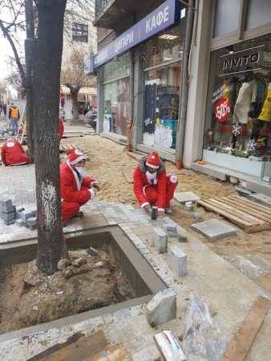
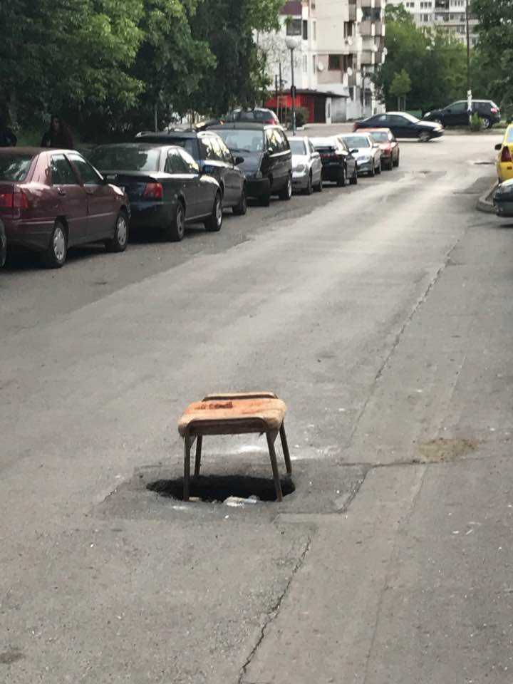
Infrastructure
Facebook / Забелязано в София

Slide 3
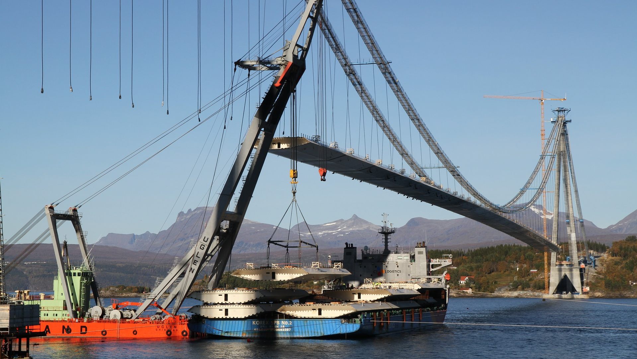

Slide 4
Infrastructure
If you do a good job,
no one shall notice

Slide 5
DOCUMASTER
established in 2014
3 products
From 3 to 200+ customers in 5 years
80+ employees
Offices in Oslo, Ålesund, Stockholm and Sofia
Approval from the National Archives
on Noark archive standard (Noark 5)
Notes:
Our company started in 2014

Slide 6
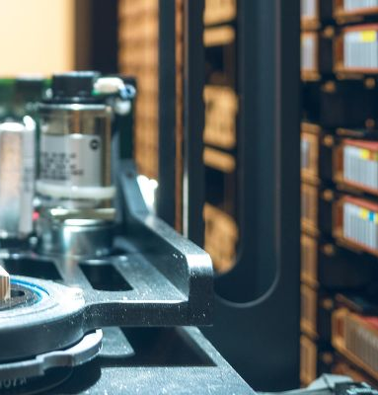
Archives
More storage
Security and protection
Long term preservation

Slide 7
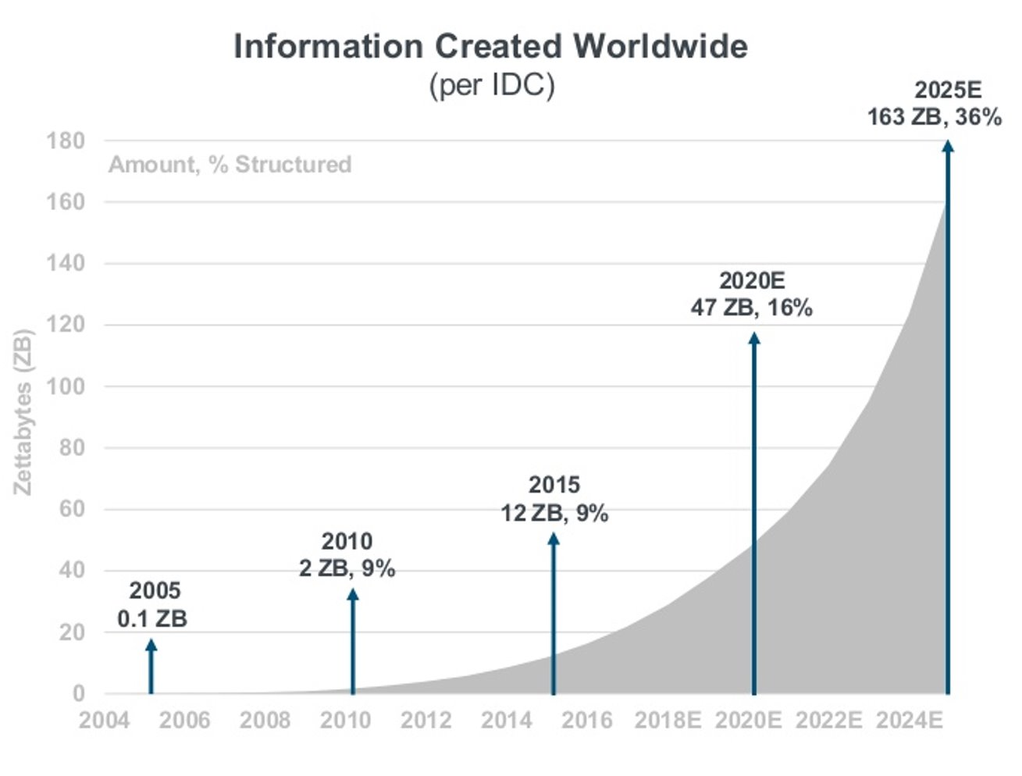
Recently corrected to 175ZB in 2025
Digital data grows even faster

Slide 8
Scalability
Integrity
Security

Slide 9
What do we need?
Scalable Infrastructure
Data Integrity
Security

Slide 10
Looking back
Virtual Machines (VPS)
Now?
LXC Containers (Managed)

Slide 11
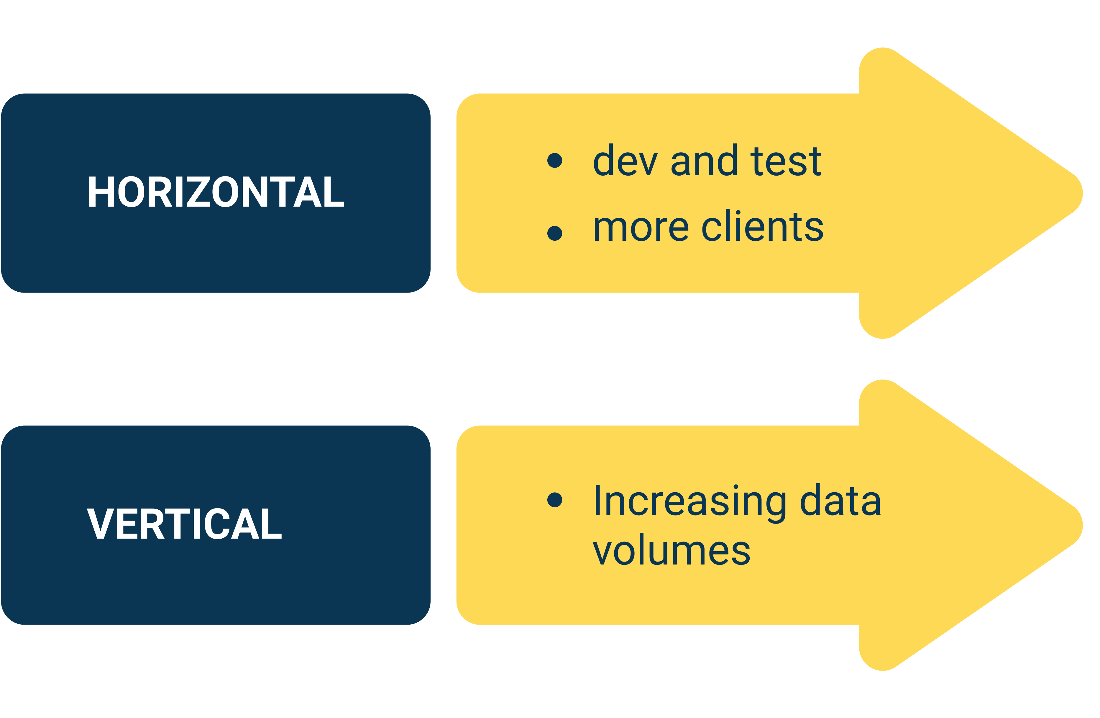
Scalability
Future-proof
Easy to deploy
Easy to manage

Slide 12
What are the options
Public Cloud
Scalable
Sort of secure
Tough with jurisdiction
Private Cloud (VMs)
Sort of scalable
Pretty secure
Increasing overhead
Containers
Good scaling
Secure enough
Lightweight

Slide 13
Containers
LXC
...
Openshift
Kubernetes
Docker
LXD
Linux Namespaces
Filesystem
Cgroups

Slide 14
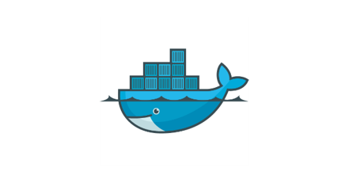

1 application = 1 container
Process in the background
Keep data out of containers – use volume
Do not use SSH
Avoid manual configurations in containers
Ephemeral
VM like
Simpler management
CPU/RAM/Volumes
Persistent

Slide 15

Use the right tools
  We don't have dynamic workloads
  We need persistency
  We need good isolation
  We need security and data protection

Slide 16
Private cloud
Router
Container
Container
Container
Container
Container
Container
Container
Container
Container
LXD
LXD
LXD
Physical Host
Physical Host
Physical Host

Slide 17
LXD
Fast deployment
Low overhead
Multiple applications
Scalable ( 40+ containers on a host )
Well supported
Orchestration (OpenNebula)
Clustering (LXD3.0)
Automation (Ansible)

Slide 18
Scalability
Integrity
Security

Slide 19
LXD
Storage backend
 | LVM | Btrfs | ZFS
Image storage | ✔ | ✔ | ✔
Container creation | ✔ | ✔ | ✔
Snapshot creation | ✔ | ✔ | ✔
Image transfer | ✘ | ✔ | ✔
Container transfer | ✘ | ✔ | ✔
Copy on write | ✔ | ✔ | ✔
Block based | ✔ | ✘ | ✘
Instant cloning | ✔ | ✔ | ✔
Nesting support | ✘ | ✔ | ✘
Recursive rollback* | ✔ | ✔ | ✘
Storage quotas | ✘ | ✔ | ✔

Slide 20
LXD ♥ ZFS
For the sake of sanity

Slide 21
ZFS RAID-Z
RAIDZ2
Up to 800 MB/s with rotating disks
Up to 12000 MB/s with NVMe
LXD
ZFS
/dev/sda
/dev/sdb
/dev/sdc
/dev/sdd
/dev/sde
/dev/sdf
/dev/sdg
/dev/sdh

Slide 22
ZFS
Filesystem
Quotas
Logical
Volume management
Physical
Data redundancy
Performance
Integrity
One more thing

Slide 23
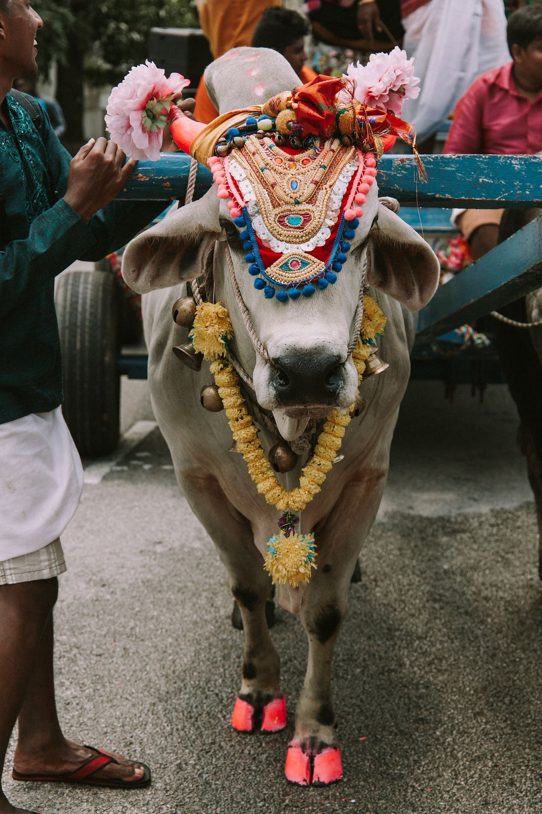
CoW
Copy on Write

Slide 24
Backup & restore
Take snapshots
(CoW)
Transfer to backup host
In case of emergency
Transfer back to LXD host
Restore container

Slide 25
Cloning / migration
Clone snapshot to a new volume
Attach the volume to container
Start a new container
Take a snapshot
Stop the source container
Sync changes
Send / Receive
the snapshot
Start destination

Slide 26
ZFS
Holy CoW
Fast cloning of container
Migrations (zfs send | zfs receive)
Backups & Recovery (simplesnap)
Robust, stable and proven

Slide 27
ZFS
ZFS eats RAM
You can restore only to the latest snapshot
The quota vs. refquota
Data
Snaps
quota

Slide 28
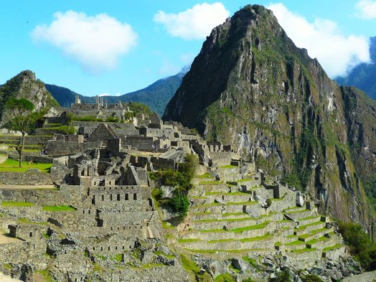
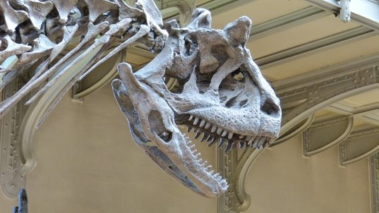
ZFS on top of HARDWARE RAID
Don't do it

Slide 29
Scalability
Integrity
Security

Slide 30
Security
Application ✔
Network ✔
Data ✔
Physical ?!

Slide 31
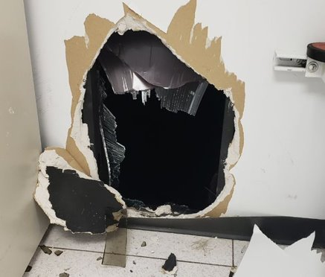
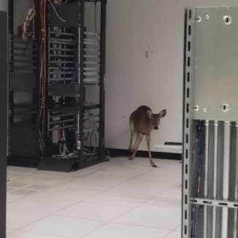
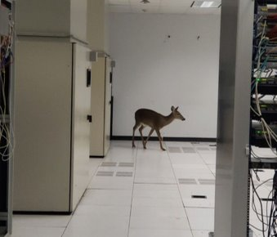
Security
Should I care or should I go now?
www.datacenterdynamics.com

Slide 32
Linux Unified Key Setup
(LUKS)
against
the intruders

Slide 33
LXD
ZFS
/dev/sda
LUKS
/dev/sdc
/dev/sdd
/dev/sde
LUKS
LUKS
/dev/sdh
LUKS
/dev/sdb
LUKS
LUKS
LUKS
/dev/sdf
/dev/sdg
LUKS

Slide 34
LUKS
Protects data from physical breach
Protects in case of decommissioning
No practical performance cost
Requires manual intervention in case of reboot
One more layer of security

Slide 35
Scalability
Integrity
Security

Slide 36
Overview
Router
Container
Container
Container
Container
Container
Container
Container
Container
Container
LXD
LXD
LXD
ZFS
ZFS
ZFS
ZFS
Physical Host
Physical Host
Physical Host
Backup Host

Slide 37

Scalable and secure infrastructure
Stoil Stoilov
stoilov.net
stoil@stoilov.net

